Slide 1


Team 2
Caring From Within - 2:30PM

Slide 2



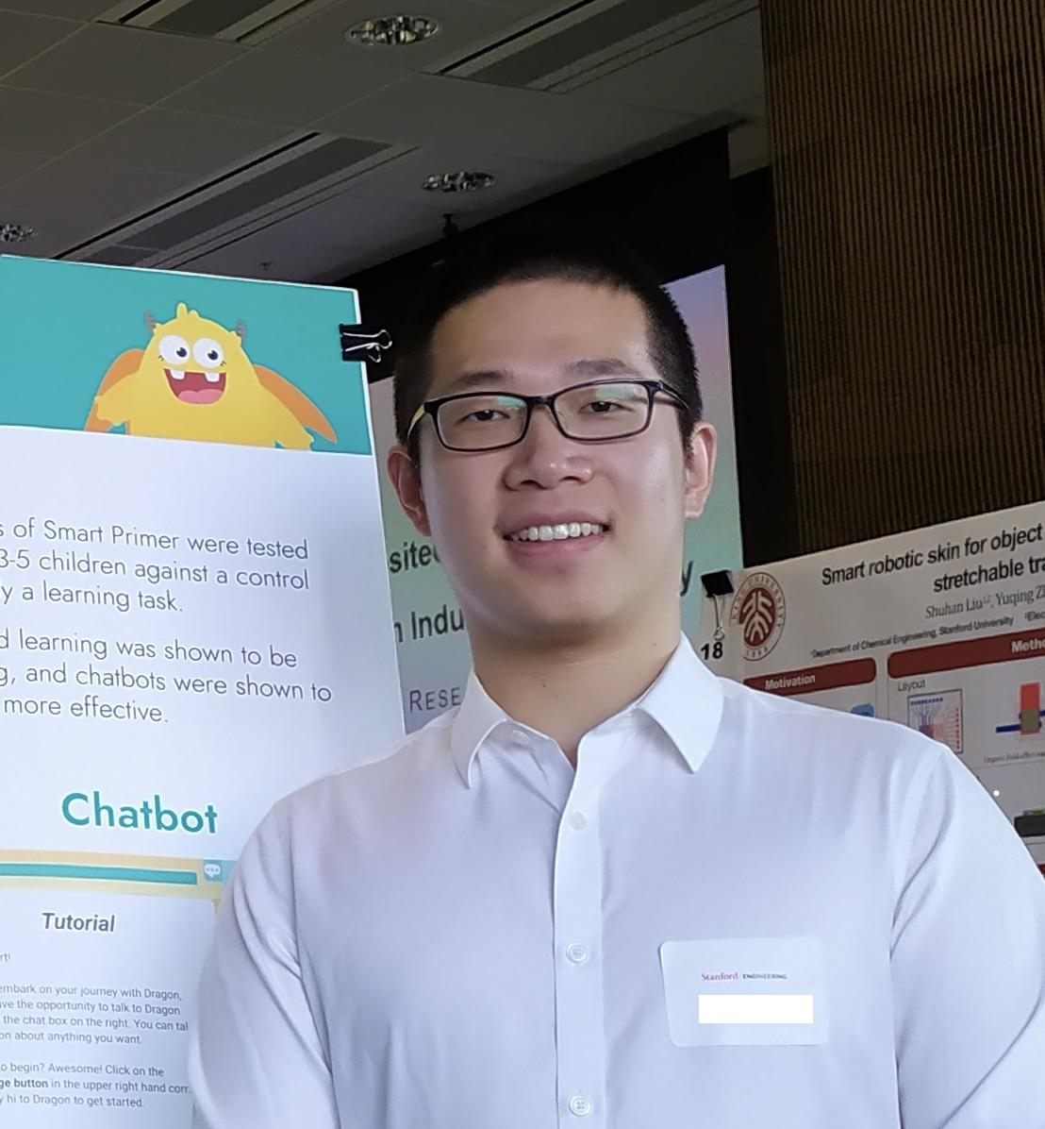
Our Team
Meng G.
UX Researcher
M.S. Symbolic Systems, C/O ‘23
Catherine H.
Product Manager
B.S. Computer Science (HCI),
C/O ‘23
Dyllen N.
Product Designer
B.S. Human-Centered Design and Engineering,
C/O ‘24
Rui Y.
Software Engineer
M.S. Computer Science (HCI), C/ O ‘23

Slide 3
Additional
Needfinding
Problem +
Solution Overview

Slide 4
Guided exercises and personalized advice to promote
healthy communication and conflict resolution
between parents and children.
Gamify
Conflict Resolution
Exercise
Parenting Skills
1
2
Incentivize parents and kids to solve problems together following best practices, and reward agreement follow-through.
Use quizzes to practice the parenting skills you want to improve, so that you can apply them to real life.
Additional features
Expert Q&A
4
3
Personalized feed of articles tailored to parents’ needs and circumstances, affirmation reminders, progress tracking dashboard, etc.
Submit questions and receive responses and recommendations from parenting experts.

Slide 5
Additional
Needfinding
Market Research

Slide 6

Relevant solution 1 - Spring Health
Solution: Precision Mental Healthcare
“Using clinically-proven machine learning models, we accurately assess an individual’s needs and then our experienced care navigators guide the individual to the right care, whether it’s coaching, meditation, therapy, medication or more.” (source)
Spring Health recently launched family mental health resources, including relationship counseling, pediatric mental healthcare, parental coaching, self-guided exercises for parents, and adult therapy for individuals.

Slide 7
What worked for Spring Health? | How does it differ from our solution?
Personalization of mental health solutions collect a comprehensive set of data on each individual use peer-reviewed machine-learning models to match each person to the right care for them; Short waiting time for healthcare Instant mental health exercises available short waiting time for therapist appointment Scientific approach solutions backed by clinical tests and research Go beyond connecting customers with healthcare providers by tracking symptoms and progresses | All-round vs. Deep dive into parenting Spring health offers mental health support for all conditions; We focuses on parenting, and specifically conflict resolution between parents and children Parent/kid separated services vs. promoting parent-kid collaboration Spring health provide parenting coaches and pediatric therapists, emphasizing addressing the problems with each family member; Our core solutions emphasize personal growth of parents and aims to improve parent-kid collaboration in solving conflicts. Healthcare platform vs. personal growth platform Spring health aims to provide accessible healthcare for mental health when a parent is in crisis; We hopes to help parents make improvements day by day to prevent more serious mental health problems from happening

Slide 8
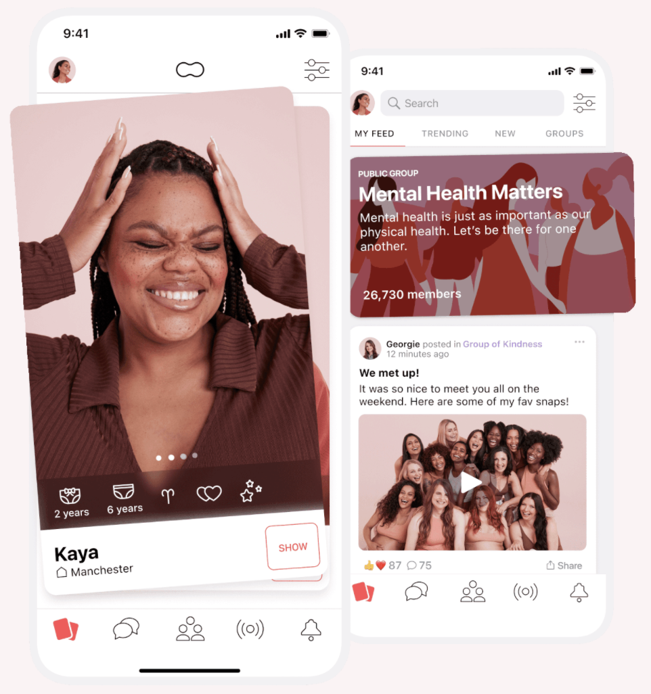
Relevant Solution 2 - Peanut
Solution: A safe space for women to meet and find support
“Connect with women who are at a similar stage in life–from fertility, pregnancy and motherhood through to menopause. Peanut provides access to a community who are there to listen, share information and offer valuable advice.” (source)
Meet
Groups
Discover women nearby who are at a similar stage in life.
Join groups and find communities with common interests.
Share
Pods
Ask questions, get advice and share stories across meaningful topics.
Join live audio conversations hosted by experts.
Notes:
Meet
Share
Ask questions, get advice and share stories across meaningful topics.
Pods
Join live audio conversations hosted by experts.

Slide 9
What worked or didn’t work for Peanut? | How does it differ from our solution?
A stand-alone social network for moms What worked: make sure the majority of users are moms What didn’t work: could not integrate with other social networks; the connection pool is limited compared to facebook groups, etc. Every mom can share their experience What worked: provides a space for moms to share their feelings, questions, etc. and get feedback What didn’t worked: unfiltered quality of sharing, misleading suggestions, users ganging up against other users. Anonymous posting What worked: offers mom a safe outlet for what they wouldn’t share in real life; What didn’t worked: moms posts hatred language, abuse, or even suicidal content that might make other moms feel stressed. | Targeting moms vs. targeting all parents Peanut is a mom-only community but our solution welcome all parents. Everyone can share vs. experts give you advice Peanut encourage experience sharing and helps users to connect with moms with similar conditions; moms can get advice from other similar moms, but the advice quality depends; Our solution hopes to offer high quality suggestions from experts targeted at parents’ specific conditions to ease the anxiety parents had about finding the “right” answer. Social vs. Personal Peanut focuses on connecting moms and create a community for sharing; We believe that parenting is a journey of self-improvement, and parents just need to compare with themselves instead of comparing with others.

Slide 10
What Makes Our Solution Unique
Personalized, Trusted Advice
Inclusiveness
1
4
As long as you want to grow as a parent, whether you are a dad, mom, grandma, or step-father, you can find useful information in Nurtue!
We offer instant solutions recommended by experts that fit your specific condition so you don’t need to worry about whose advice to take.
2
3
Self-improvement Companion
Productive
Conflict Resolution
We believe parenting is primarily a self-improvement journey, and we help you to keep track of your progress. You don’t need to worry about what others parents do; instead, just focus on yourself.
We provide a positive perspective to view conflicts and make it a fun opportunity for parents and children to grow together by gamifying conflict resolution and rewarding communication.

Slide 11
Additional
Needfinding
Tasks

Slide 12
Tasks
Connect with an expert who can provide personalized advice to help you work through a specific situation you're facing with your child's behaviors.
Simple
Level of involvement between parent and children
Practice using more effective language to communicate with a child.
Moderate
Resolve a particular conflict with a child in a peaceful manner, and come to a filed agreement that the parent can reference.
Complex
The story versions of tasks can be found in speaker notes.
Notes:
Story versions:
Simple: Tina is struggling to manage her pre-teen daughter’s disobedience. She knows that the father’s absence is contributing to this, and wants to find expert advice to her specific situation.
Moderate: Felipe has realized that scolding his daughter has only made her more secretive. He wants to practice using more effective language to communicate with her.
Complex: Dan is upset that his son plays video games instead of doing his schoolwork. His son becomes upset when Dan takes away his video game privileges. Dan wants to come to an agreement with his son and resolve their conflict and follow through the agreement.

Slide 13
Additional
Needfinding
Values in Design

Slide 14
Conflicting Values
How to Address
Is there a “right” way to raise a child?
Who can say what’s the right way to raise a child?
How to protect parents’ privacy?
Some parents might feel uncomfortable to share personal information.
Will it leads to longer screen time?
It’s likely that some parents might spend their attention on the app too much instead of on their children.
Give parents choices
We should allow parents to choose preferred parenting styles and personalize the advice they get.
Ensure data security
We should make sure data stored are anonymized and give parents control of what information they share with the app.
Promote real-life interactions
Encourage real-life interactions between parents and children and potentially offer screen time checker.

Slide 15
Additional
Needfinding
Video Storyboards

Slide 16
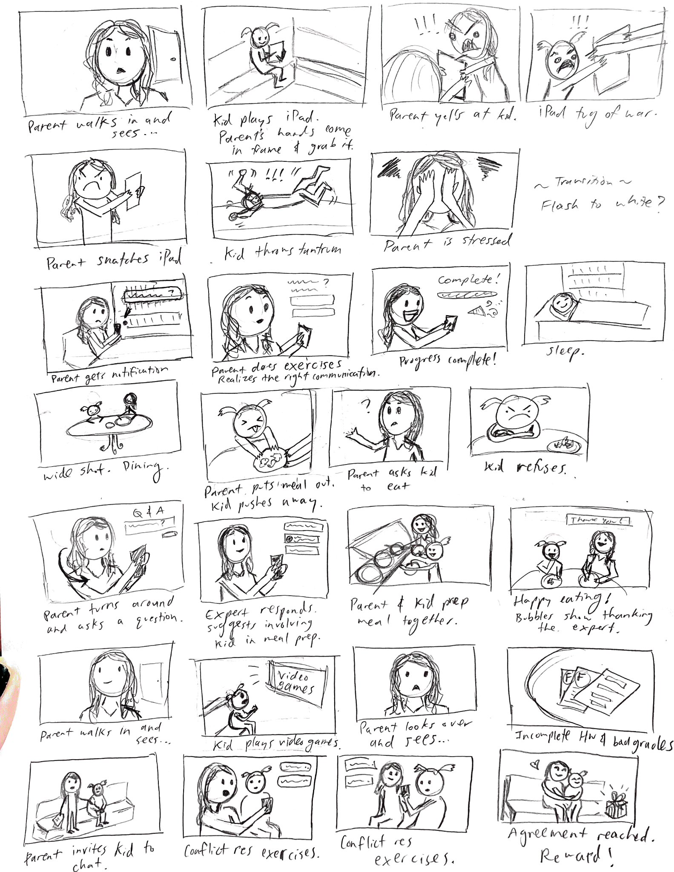
Scene 1: Fighting over iPad Usage
Moderate Task:
Learn and practice parenting best practices such as using more effective language
to communicate with a child.

Slide 17
Scene 2: Dealing with Picky Eating
Simple Task:
Connect with an expert who can provide personalized advice to help you work through a specific situation you're facing with your child's behaviors.

Slide 18
Scene 3: Settle an Agreement on Playing Video Games vs. Getting Homework Done
Complex Task:
Resolve a particular conflict with a child in a peaceful manner, and come to a recorded agreement.

Slide 19

Concept Video

